Slide 1
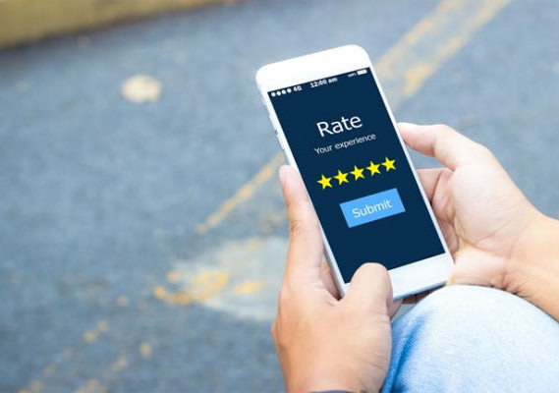
BT4222: Mining Web Data for Business Insights
Final Presentation / 17 Apr 2020
Online Fake Review Detection
On Yelp’s Case
Zhou Bangda ()
Business Analytics
xxxxxx@u.nus.edu
Jasvinder Singh()
Business Analytics
xxxxx@u.nus.edu
Zuoling Xiao (A0162759R)
Business Analytics
Zuoling.xiao@u.nus.edu
Carol Shen()
Business Analytics
xxxx@u.nus.edu
Disclaimer: This document was prepared and accomplished by a group of NUS SOC student in their personal capacity. The opinions expressed in this document are the author's own and do not reflect the view of the National University of Singapore, School of Computing, or Singapore Health Services

Slide 2
Today’s Agenda
1. Background
2. Data Source
3. Exploratory Data Analysis
4. Feature Engineering
5. Model Building
6. Limitations
7. Conclusion

Slide 3
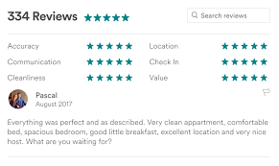
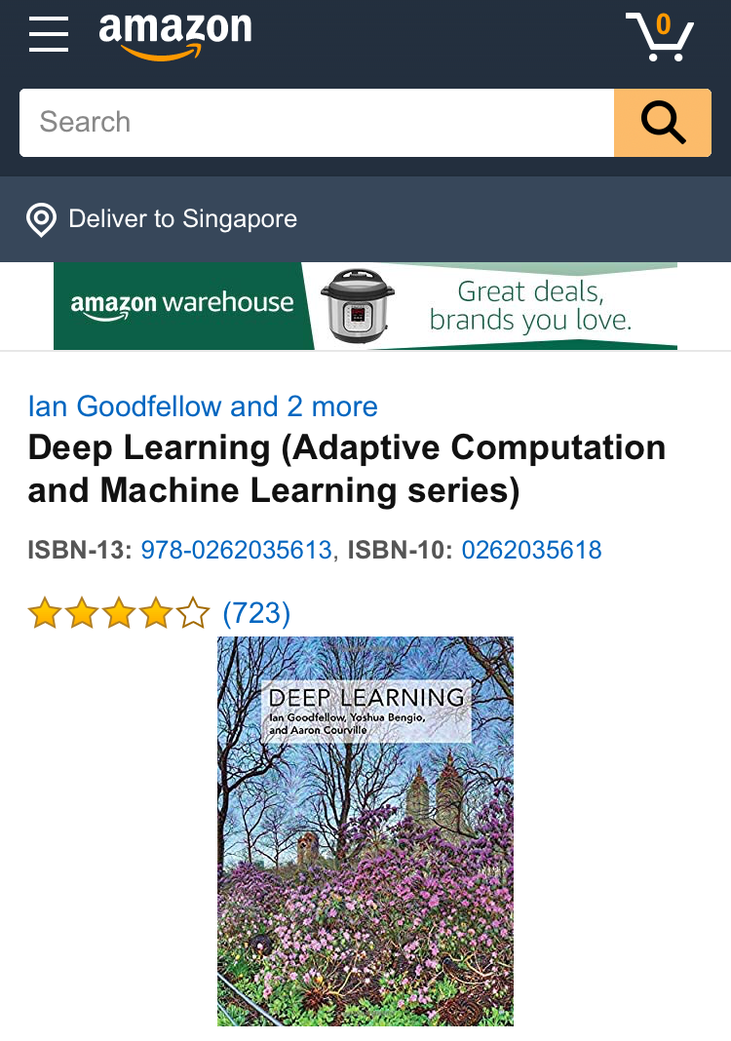

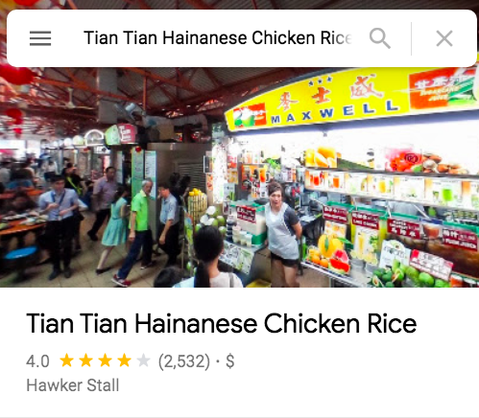


Online Review Are the Essential in Digital Economy
It’s nearly everywhere…

Slide 4
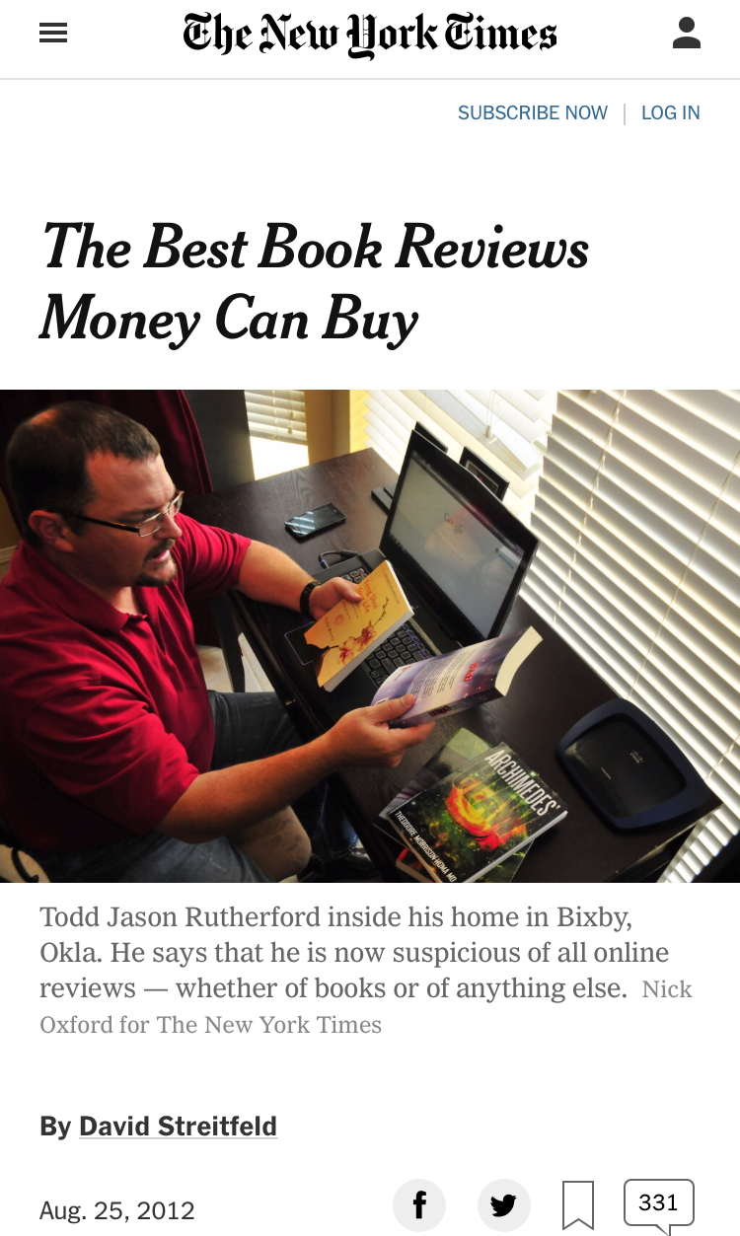
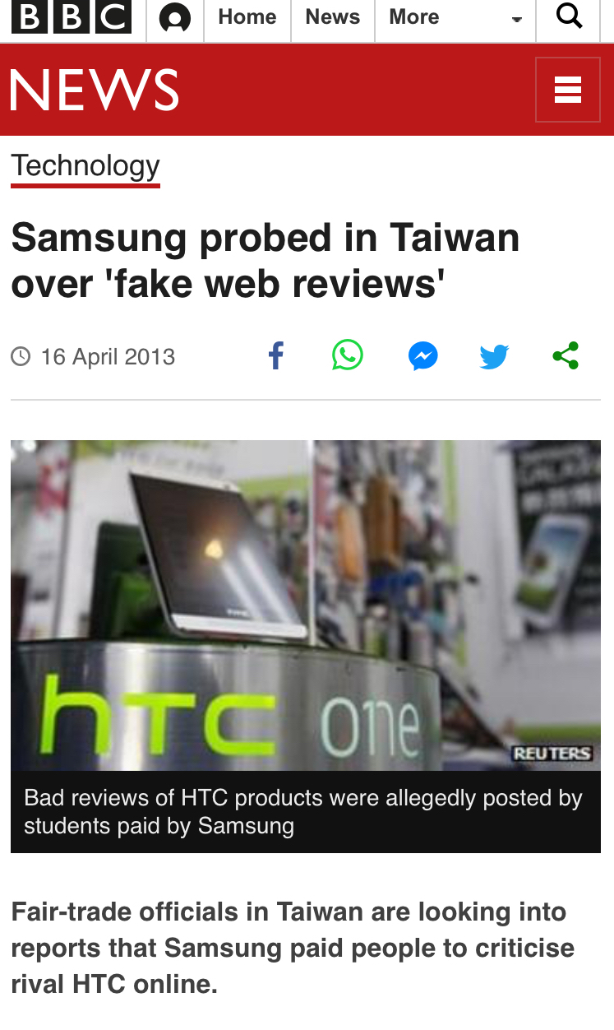
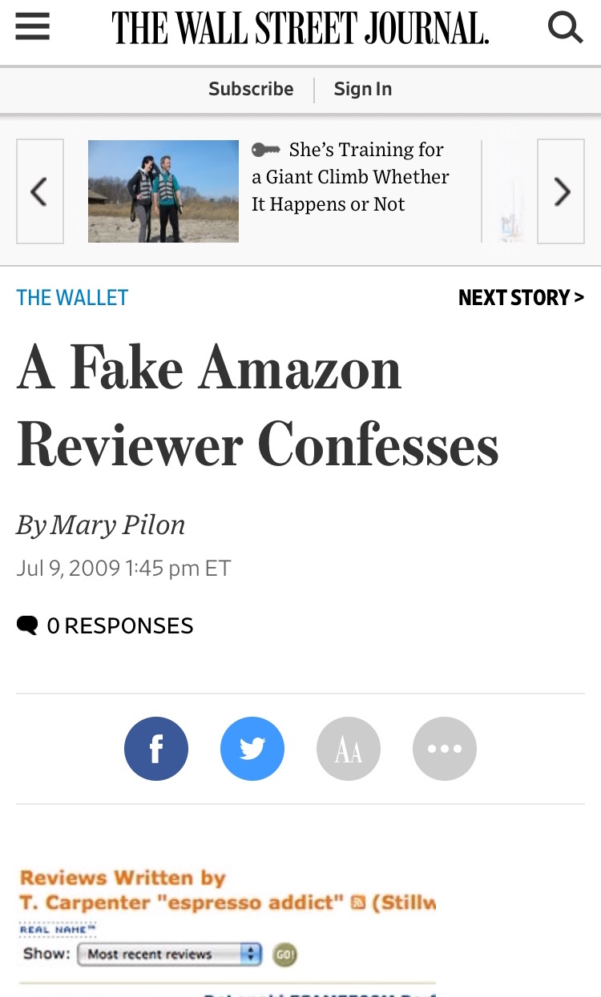
However, Those Reviews Could Be Bought…

Slide 5
Today’s Agenda
1. Overview
2. Algorithm - Data Processing
3. Algorithm - Risk Assessment
4. User Interface - Live Demo
5. User Experience
6. Limitations
7. Conclusion

Slide 6
Today’s Agenda
1. Overview
2. Algorithm - Data Processing
3. Algorithm - Risk Assessment
4. User Interface - Live Demo
5. User Experience
6. Limitations
7. Conclusion

Slide 7
Today’s Agenda
1. Overview
2. Algorithm - Data Processing
3. Algorithm - Risk Assessment
4. User Interface - Live Demo
5. User Experience
6. Limitations
7. Conclusion

Slide 8
Today’s Agenda
1. Overview
2. Algorithm - Data Processing
3. Algorithm - Risk Assessment
4. User Interface - Live Demo
5. User Experience
6. Limitations
7. Conclusion

Slide 9
Today’s Agenda
1. Overview
2. Algorithm - Data Processing
3. Algorithm - Risk Assessment
4. User Interface - Live Demo
5. User Experience
6. Limitations
7. Conclusion

Slide 10
Today’s Agenda
1. Overview
2. Algorithm - Data Processing
3. Algorithm - Risk Assessment
4. User Interface - Live Demo
5. User Experience
6. Limitations
7. Conclusion

Slide 11
What We Have Done…
1.
2.
3.
4.
Design the
Build the
Align with
Solve client

Slide 12
Q & A
Thank You!

